Slide 1


Research Data Management for researchers
Sarah Jones & Jonathan Rans
Digital Curation Centre

Slide 2
About this course
Short presentations with exercises and discussion
  Overview of research data management landscape (Jonathan Rans)
  Data sharing exercise
  Introduction to data management planning (Sarah Jones)
  Data management planning exercise
  RDM support and activity at Glasgow (Valerie McCutcheon)
Coffee break halfway through, after data sharing exercise
But first...

Slide 3
Quiz: What do research funders expect?
Funders’ expectations with regards to data management and sharing have
changed quite dramatically over the past few years.
Take ten minutes to complete this quick
quiz to see how familiar you are with these
new requirements.

Slide 4
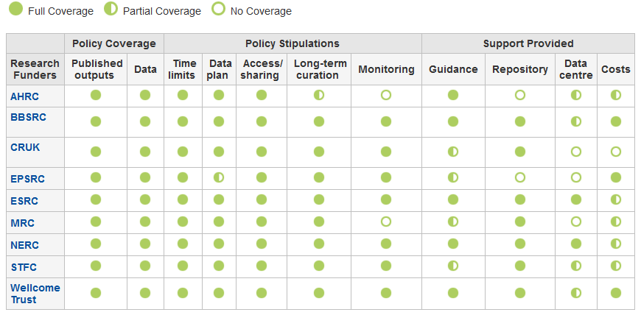
What do research funders expect?
www.dcc.ac.uk/resources/policy-and-legal/overview-funders-data-policies
Notes:
As noted, funders’ requirements have changed in recent years. If in doubt, it is always advisable to check to ensure that you understand what is expected of you.
The DCC has produced an at-a-glance overview of UK funders’ policies with regards to data management planning and sharing.
If you click on any of the funders on the left hand side of the screen, you will find more detailed information about what that funder expects.
DCC updates this table frequently.

Slide 5
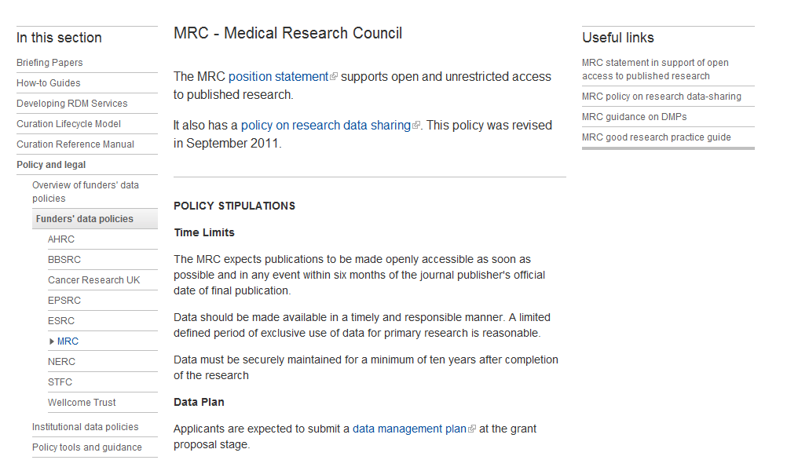
Notes:
Here is an example of the more detailed information you’ll find if you click on any of the funders in the policy overview table.
DCC provides a collection of useful links to funder guidance and other external resources.

Slide 6
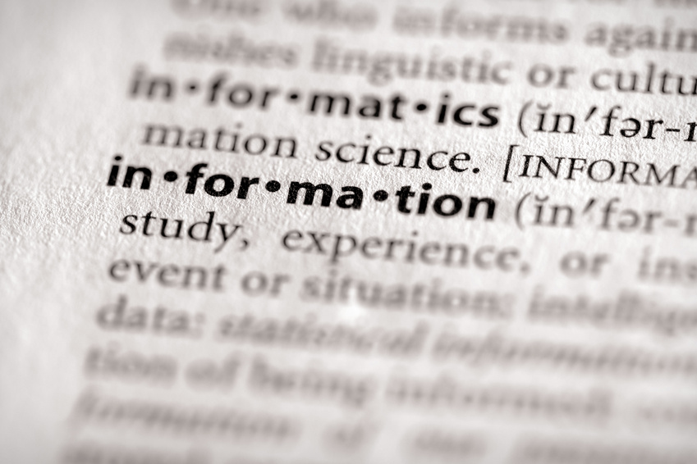
Defining research data
Research data are collected, observed or created,
for the purposes of analysis to produce and validate original research results
Notes:
Important to remember that research data may include bits of software and algorithms that are developed to perform analysis or to visualise the data. In many cases, these are of higher value than the data themselves (e.g., in some gene sequencing projects the algorithms are the main research output – not the genetic code data itself).
‘In the context of these Principles and Guidelines, “research data” are
defined as factual records (numerical scores, textual records, images and
sounds) used as primary sources for scientific research, and that are
commonly accepted in the scientific community as necessary to validate
research findings. A research data set constitutes a systematic, partial representation
of the subject being investigated.’
OECD PRINCIPLES AND GUIDELINES FOR ACCESS TO RESEARCH DATA FROM PUBLIC FUNDING – © OECD 2007

Slide 7

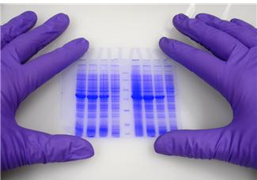
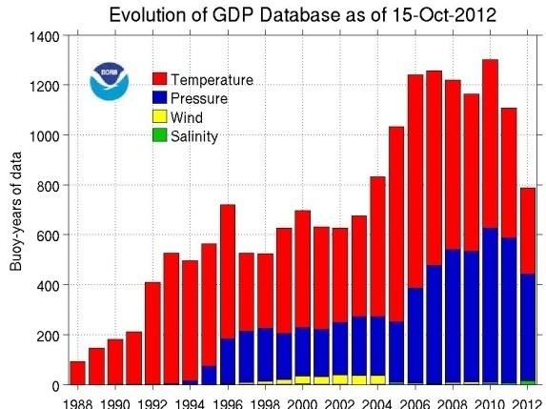


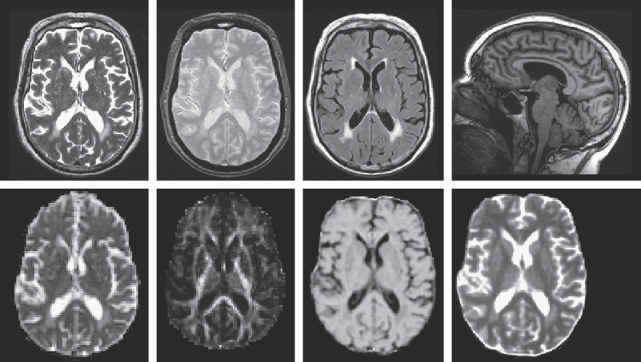

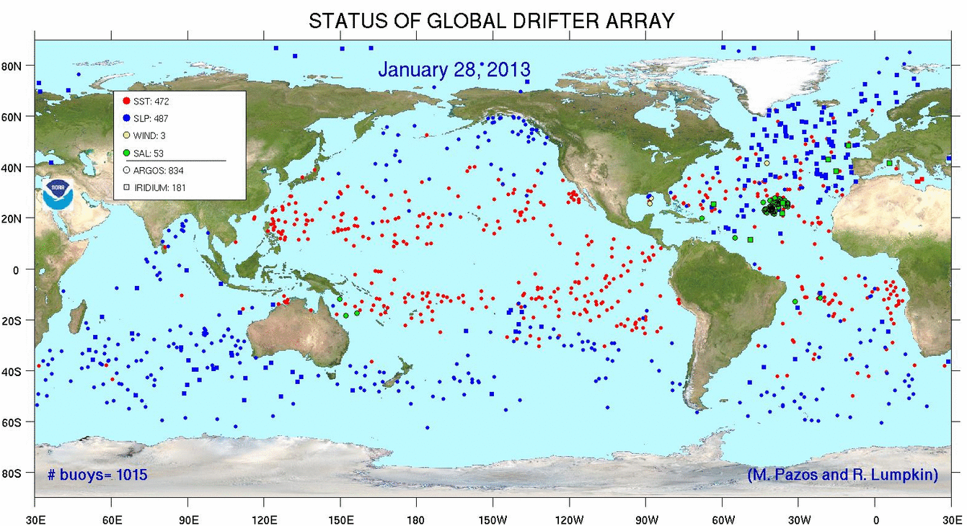
So, what might this include?
http://www.aoml.noaa.gov/phod/dac/array_growth.html
http://www.sbirc.ed.ac.uk/documents/lbc_protocol.pdf
Anything & everything produced in the course of research
http://www.aoml.noaa.gov/phod/graphics/dacdata/globpop.gif
Notes:
Instrument measurements
Experimental observations
Still images, video and audio
Text documents, spreadsheets, databases
Quantitative data (e.g. survey data)
Survey results & interview transcripts
Simulation data, models & software
Slides, artefacts, specimens, samples
Questionnaires
Sketches, diaries, lab notebooks …

Slide 8
What activities are involved in research data management (RDM)?
Data Management Planning
Creating data
Documenting data
Accessing / using data
Storage and backup
Sharing data
Preserving data
Create
Document
Use
Share
Preserve
Store
Notes:
Essentially, research data management covers all aspects of research planning, creation, storage, sharing and longer-term preservation, discovery and reuse.
Data management planning stage:
Researchers need to provide the details on what data might be captured, in what quantities, and what formats might be used. As noted previously, estimates at this stage are ok. Funders don’t expect everything to be carved in stone at the application stage and are merely looking for evidence that some consideration has been given to the nature and scale of the data that might be produced within the project and how this will be managed and shared.
Data management planning will be covered in more detail by Sarah in the next session.

Slide 9
Data creation
Decide what data will be created and how - this should be communicated to the whole research team
Develop procedures for consistency and data quality
  Choose appropriate software and formats - some are better for long-term preservation and reuse
  Ensure consent forms, licences and partnership agreements don’t limit options to share data if desired
Notes:
Clarify copyright before research starts
Consider licensing options e.g. Creative Commons
When starting a new project, it is important to check to see if the work is duplicating data that has already been collected/generated. Funders are keen to avoid funding new projects to reproduce data that has already been collected. At a minimum, it is a good idea for researchers to carry out a search of any data centres that are supported by the funder they are seeking support from. For instance, researchers seeking ESRC funding should at least carry out a search of the data available in the UK Data Service. It might also be a good idea for researchers to consult subject librarians in their institutions for advice on other data sources to check.
It is crucial that researchers bear in mind any restrictions that are associated with consent forms used within the project and that the data management plans and pathway to impact statements do not contradict what is said in the consent form. For example, if the consent forms states that all data collected will be destroyed following the project, then this should be stated in the data management plan and pathway to impact statement. In many cases, different people may complete different parts of the grant application so ensuring that there is consistency between these three elements will be crucial. If working with sensitive personal data, it is a good idea to have someone from the ethics committee review the data management plan.

Slide 10
Documentation
Collect together all the information users would need to understand and reuse the data
Create metadata at the time - it’s hard to do later
Use standards where possible
Name, structure and version files clearly
Notes:
Consider who is going to use the data, you might require more detail if someone unfamiliar with the specific research environment is going to access the data
It is a good idea to use standards when collecting and documenting data. For example, the Data Documentation Initiative (DDI) which is an international metadata standard for the social and behavioural sciences may be a useful metadata standard to use for population health studies. Standards are like toothbrushes…
MRC provides some excellent guidance on standards that might be relevant for health researchers in its Policy and Guidance on Sharing of Research Data from Population and Patient Studies, v01-00, 23 November 2011
Hertfordshire also provide a standard folder structure to researchers to use in new projects to help organise their data during the active phase.

Slide 11
Access and use
Restrict access to those who need to read/edit data
Consider the data security implications of where you store data and from which devices you access files
Choose appropriate methods to transfer / share data
  filestores & encrypted media rather than email & Dropbox
Notes:
UK Data service (formerly UKDA) provides excellent guidance on how to anonymise data and, more importantly, tips on what data to collect to avoid a vast amount of effort going into redacting data to allow it to be shared (i.e., assessing whether you need to collect certain fields of information early can mean you avoid having to redact it out later at a cost).
Determinants of young Adult Social well-being and Health (DASH) study group here at Glasgow has some very good advice on data sharing processes that can reduce accidental dissemination of sensitive data.
DASH Data Sharing Policy November 2012 version 1_draft 2

Slide 12
Storage and backup
Use managed services where possible e.g. shared drives rather than local or external hard drives
Ask the local IT team for advice
3… 2… 1… backup!
  at least 3 copies of a file
  on at least 2 different media
  with at least 1 offsite
Notes:
Researchers should contact local or central IT services for advice on short term and longer term storage requirements. It is important to get this started early enough to be able to identify any additional costs that may need to be factored into the grant application.
Most researchers work using collaborative tools such as DropBox and Google Docs. Janet are offering some more secure cloud-based spaces to help researchers. Talk to IT support to make sure what you plan to use is fit for purpose.
Researchers will need to think about how data will be backed-up if they plan to work outside the university system (i.e., remotely using laptops or personal devices).

Slide 13
Data selection
It’s not possible – or desirable - to keep everything.
Select based on:
  What has to be kept e.g. data underlying publications
  What legally must be destroyed
  What can’t be recreated e.g. environmental recordings
  What is potentially useful to others
  The scientific or historical value
Notes:
Active selection – not just at the end of the project!
At a minimum, researchers should ensure that any data required to validate published research findings are retained in line with funders’ mandates.
It is a good idea for central support to work with researchers in specific disciplines to determine what level of data would be required – raw data, algorithms, visualisations?
Leeds example
A researcher who images spines always captures more of the spinal area than he needs at a higher resolution than is needed as the image preparation phase is more expensive than the image capture phase.

Slide 14
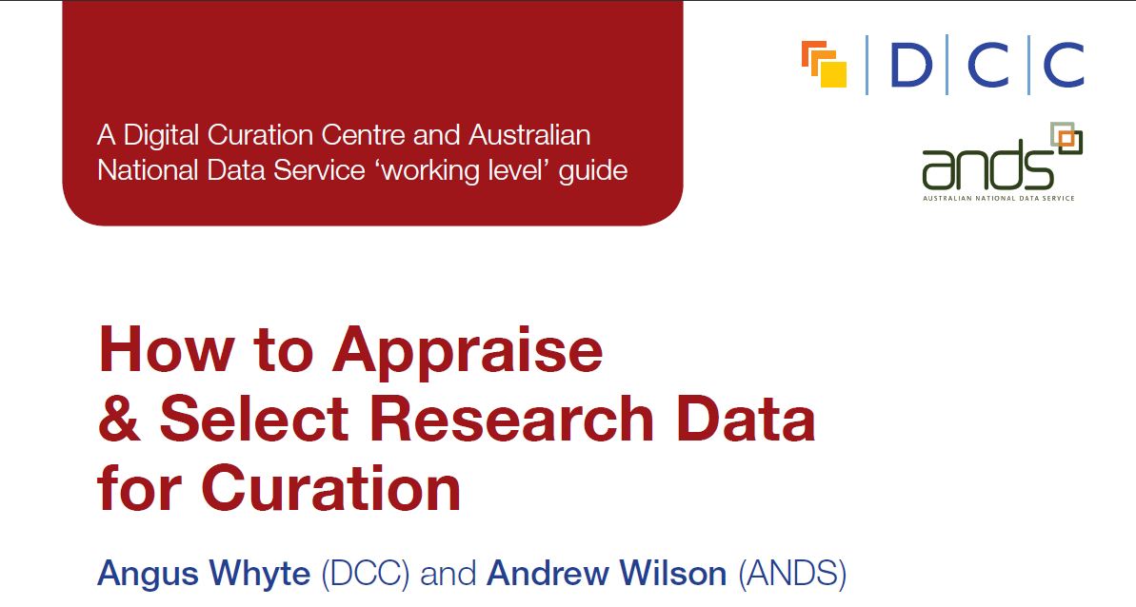
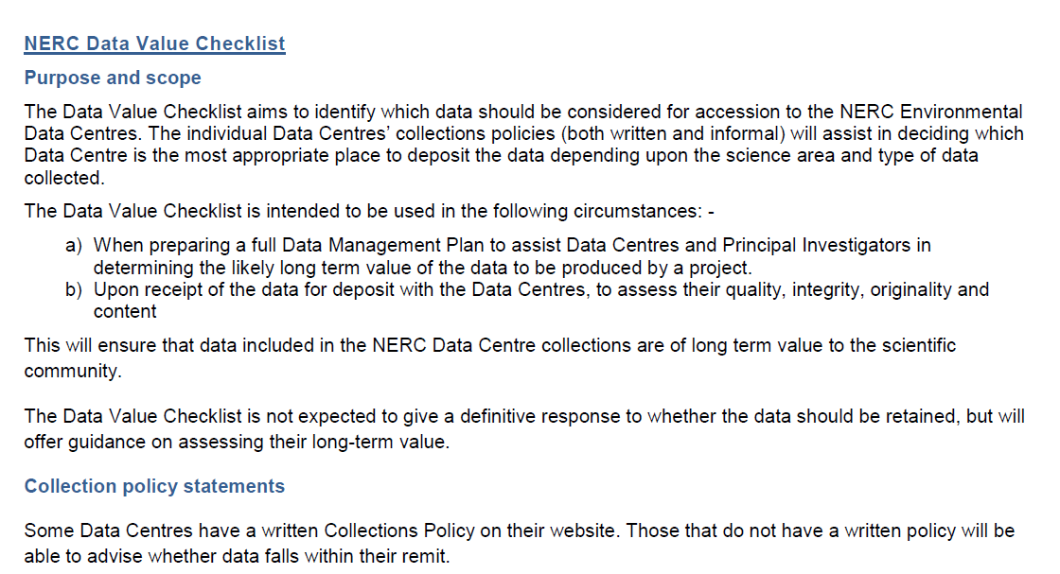
Guidance on selection and appraisal
http://www.dcc.ac.uk/resources/how-guides
http://www.nerc.ac.uk/research/sites/data/documents/data-value-checklist.pdf
Notes:
Researchers may find the NERC data value checklist useful at the pre-award stage. The checklist helps researchers to identify any potential outputs that may have longer term value and should be retained. The checklist is also used to assess quality, integrity and originality of the data at the point of deposit into a data centre once the project has been completed.
Once the project has been completed, the DCC How-to select and appraise research data might be useful in identifying data that warrants longer-term retention.

Slide 15
Data preservation
Be aware of requirements to preserve data
Consult and work with experts in this field
Use available subject repositories, data centres and structured databases
  http://databib.org
  http://www.re3data.org
Notes:
A number of UK HEIs are developing and testing data repositories and data catalogues to record data that is perhaps held outside the University (e.g., data centres). Valerie will talk about some of the work being done here at Glasgow a bit later. Jisc and DCC developing a national research data registry to assist with visiblity.
However, it is not always the case that the data will need to be held at the university. Many funders support data centres and will expect that the data is deposited at the end of the project. In these cases, the researchers just need to be sure to register this with the university so that a link between the published output(s) and the underlying data are recorded to comply with the RCUK OA policy.
In the event that there is no dedicated data centre supported by the funder and the University is unable to accept the data at the end of the project, researchers may be able to find an alternative data centre in which to deposit their data. Databib provides a searchable list of data centres by name and by subject.

Slide 16
What is data sharing?
  “… the practice of making data used for scholarly
  research available to others.” [Wikipedia]
Who’s involved?
  the data sharer
  the data repository
  the secondary data user
  support staff
Notes:
Funders don’t just want the data to be retained for validation but also to enable reuse.
There is no point in investing in retaining the data if it can’t be used. Consider who will need or want to access the data and ensure that you are aware of your funders’ expectations.

Slide 17

Why is sharing data an issue all of a sudden?
“Publicly funded research data are a public good, produced in the public interest, which should be made openly available with as few restrictions as possible in a timely and responsible manner that does not harm intellectual property.”
RCUK Common Principles on Data Policy
www.rcuk.ac.uk/research/Pages/DataPolicy.aspx
Notes:
Has been growing over the past decade. As far back as 2007, OECD declared that publicly funded research is a public good.
Quote is from RCUK Common principles.
RCUK OA policy revised in 2012 to require a statement in published papers on how to access the underlying data.
Individual funders have issued statements placing them in line with these common principles.
Some, like the ESRC and NERC offer their own infrastructure and can afford to be more proscriptive. They have made it mandatory to deposit data at the end of a research cycle.

Slide 18
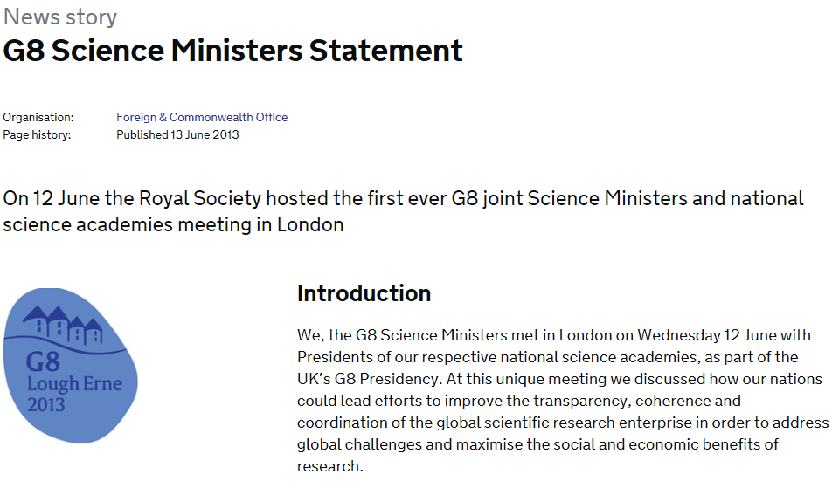
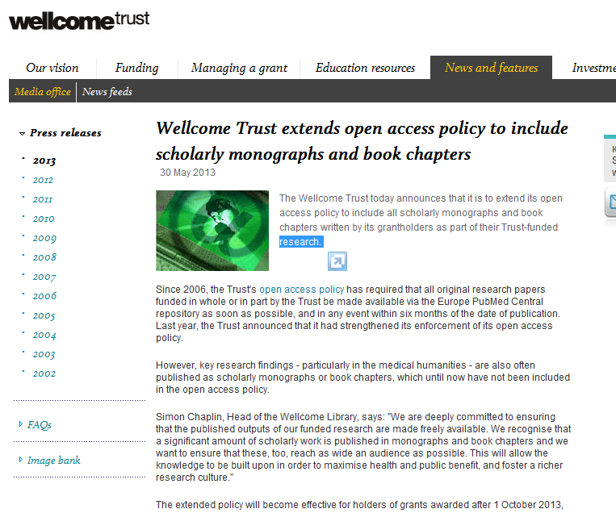

‘Conducting research on existing data sets less expensive than setting up new studies and novel linkage can widen focus’
Dr Jim Lewsey, Statistical Analysis of Linked Health Data (SALHDa), Launch of HEHTA
https://www.gov.uk/government/news/g8-science-ministers-statement
Notes:
MRC Strategic Plan (2009-2014) states that data are at the heart of MRC’s ability to improve the understanding of human health,.
Wellcome Trust has recently extended the OA mandate to include monographs as well as articles.
G8 Science Ministers statement in June 2013, open data is a key goal.
‘To the greatest extent and with the fewest constraints possible publicly funded scientific research data should be open, while at the same time respecting concerns in relation to privacy, safety, security and commercial interests, whilst acknowledging the legitimate concerns of private partners.’
Here in Glasgow University, there is also recognition that sharing data can reduce costs and increase potential for novel research. Health Economics and Health Technology Assessment (HEHTA) was launched in March 2012.

Slide 19
Exercise: barriers to data sharing
List one or two of the reasons that researchers might feel restrict their ability to share their data.
Are there any actions that could be taken to reduce or overcome these restrictions?
You have 15 minutes
Constraints on data sharing | Possible solutions / approaches

Slide 20

Reasons to share data
BENEFITS
Avoid duplication
Scientific integrity
More collaboration
Better research
Increased citation
9-30% increase shown in
study
(Piwowar H. and Vision T.J 2013 , https://peerj.com/preprints/1.pdf)
DRIVERS
Public expectations
Government agenda
RCUK Data Policy
  www.rcuk.ac.uk/research/Pages/DataPolicy.aspx
UKRIO Code of Practice for Research
  www.ukrio.org/what-we-do/code-of-practice-for-research/
Notes:
Always going to be a balance for researchers between access, data protection and commercial/IP issues. But there are ways to share if you put a bit of effort into it.
If you do put in the effort, there can be rewards.
Remember – access doesn’t have to mean that people have to mean barrier-free. You can set up terms and conditions and registration pages.

Slide 21
How to share research data
Use appropriate repositories and data catalogues
  Databib - http://databib.org
  Re3data - http://www.re3data.org
  Jisc/DCC research data registry (coming soon!)
License the data so it is clear how it can be reused
  www.dcc.ac.uk/resources/how-guides/license-research-data
Make sure it’s clear how to cite the data
    http://www.dcc.ac.uk/resources/how-guides/cite-datasets
Consider publishing a data paper based on your DMP http://metajnl.com/

Slide 22
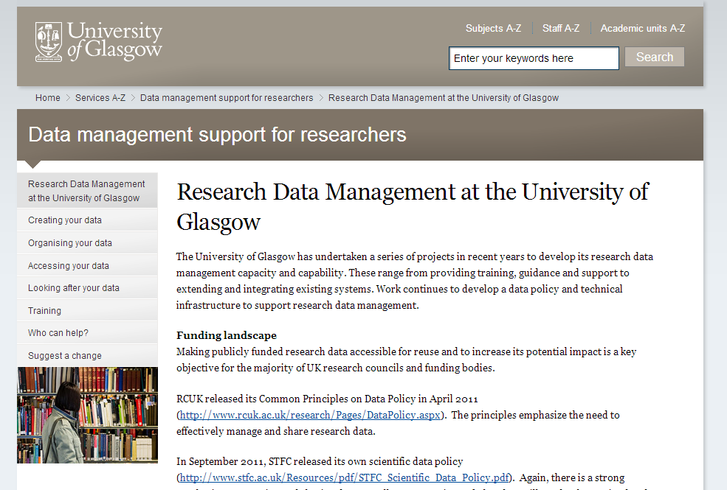
RDM support is available
www.gla.ac.uk/services/datamanagement
Notes:
Online support for all stages of RDM is offered through the university web portal.
More from Valerie later on the UoG research data catalogue.

Slide 23
Data Management Planning

Slide 24
What is a DMP?
A short plan that outlines
what data you will create and how
how you will manage it
(storage, back-up, access…)
plans for data sharing and preservation
DMPs are often submitted as part of grant applications, but are useful whenever you’re creating data.
Create
Document
Use
Share
Preserve
Store

Slide 25
Why develop a DMP?
to help you manage your data
to provide guidelines for everyone to work to
to anticipate and avoid problems e.g. duplication, data loss, security breaches...
to comply with funders requirements

Slide 26
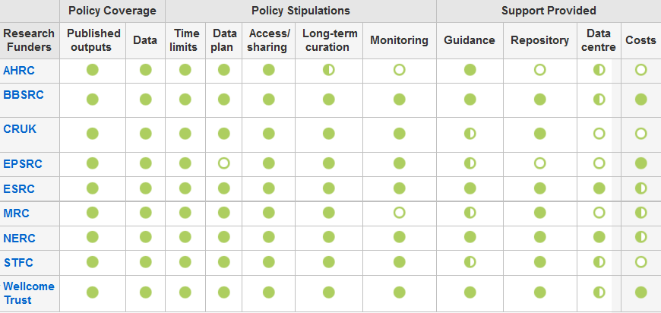
Funders have DMP requirements
www.dcc.ac.uk/resources/policy-and-legal/overview-funders-data-policies

Slide 27
What do research funders want?
A brief plan submitted in grant applications, and in the case of NERC, a more detailed plan once funded
1-3 sides of A4 as attachment or a section in Je-S form
Typically a prose statement covering suggested themes
An outline of data management and sharing plans, justifying decisions and any limitations

Slide 28
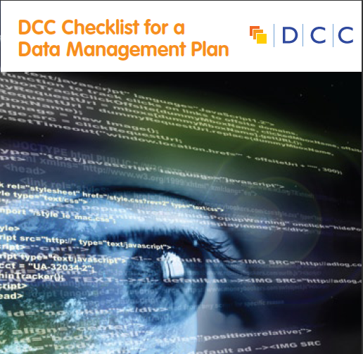
What should DMPs cover?
  What data will be created (format, types, volume...)
  Standards and methodologies to be used (incl. metadata)
  How ethics and Intellectual Property will be addressed
  Plans for data sharing and access
  Strategy for long-term preservation

Slide 29
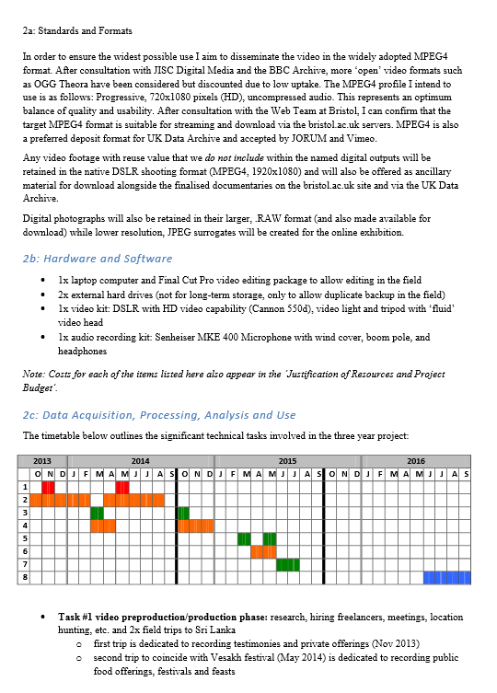
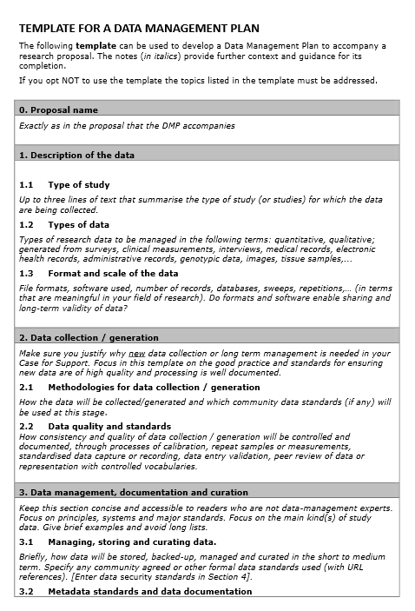
What does a DMP look like?

Slide 30
Example Data Management Plans
Technical plan submitted to AHRC by Bristol Uni
http://data.blogs.ilrt.org/research/planning/files/2013/08/data.bris-AHRC-guide-V3_0.pdf
University of Leeds examples (social science)
www.dcc.ac.uk/sites/default/files/documents/adocs/Leeds-RoaDMaP-DMPs.pdf
Rural Economy & Land Use (RELU) programme examples
http://relu.data-archive.ac.uk/data-sharing/planning/examples
UCSD example DMPs (20+ scientific plans for NSF)
http://rci.ucsd.edu/dmp/examples.html
More at:
www.dcc.ac.uk/resources/data-management-plans/guidance-examples

Slide 31
What to write: data creation example
“Raw data is stored either as Excel spreadsheet files or as MATLAB data files. In each case, column headers (for Excel) or README files (for MATLAB) provide a mechanism for understanding the data. A digital log of experimental details also provide a link to corresponding image files as well as a brief description of experimental conditions, providing context for data collection.”
From engineering DMP example by Sameer Shah from UCSD
http://rci.ucsd.edu/_files/DMP%20Example%20Shah.pdf

Slide 32
What to write: storage and backup example
“Bristol’s Research Data Storage Facility (RDSF) will be used to store the data during the project. Recordings made in the field will be copied to the RDSF via a secure web connection, by the PI, as soon as possible, but some delays are expected due to Sri Lankan facilities. Therefore an external, portable hard drive (and an identical copy, for redundancy purpose) will be used for backup in the field.”
From an example AHRC Technical Plan, University of Bristol
http://data.bris.ac.uk/research/planning/files/2013/08/data.bris-AHRC-example-Technical-Plan-v2.pdf

Slide 33
What to write: data sharing example
“We will make the data and associated documentation available to users only under a data-sharing agreement that provides for: (1) a commitment to using the data only for research purposes and not to identify any individual participant; (2) a commitment to securing the data using appropriate computer technology; and (3) a commitment to destroying or returning the data after analyses are completed.”
From NIH example data sharing plans
http://grants.nih.gov/grants/policy/data_sharing/data_sharing_guidance.htm#ex

Slide 34
What to write: restrictions on sharing
“The data will be deposited with [repository] but not disseminated for one year to give the investigators time to publish their findings.”
From ICPSR Framework for Creating a Data Management Plan
www.icpsr.umich.edu/icpsrweb/content/datamanagement/dmp/framework.html

Slide 35
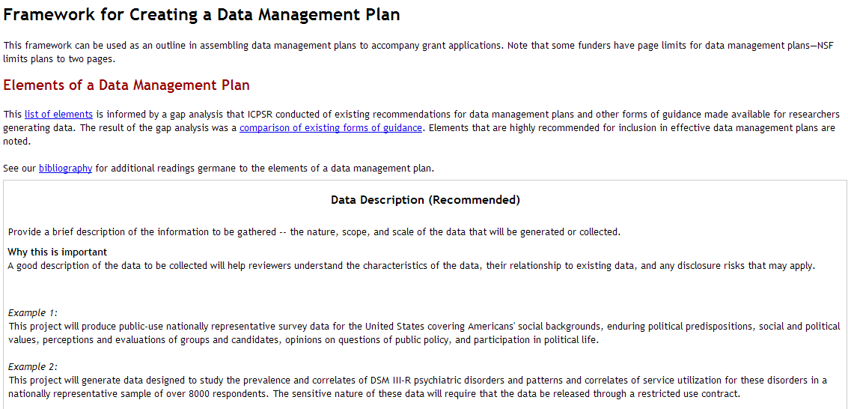
A useful framework to get started
Think about why the questions are being asked
Look at examples to get an idea of what to include
www.icpsr.umich.edu/icpsrweb/content/datamanagement/dmp/framework.html
Notes:
I recommend this ICPSR resource
It explains the importance of different questions as a pointer to how to answer
Examples are given. This is the most frequent request we get at DCC - examples help researchers think of what to write for their context

Slide 36
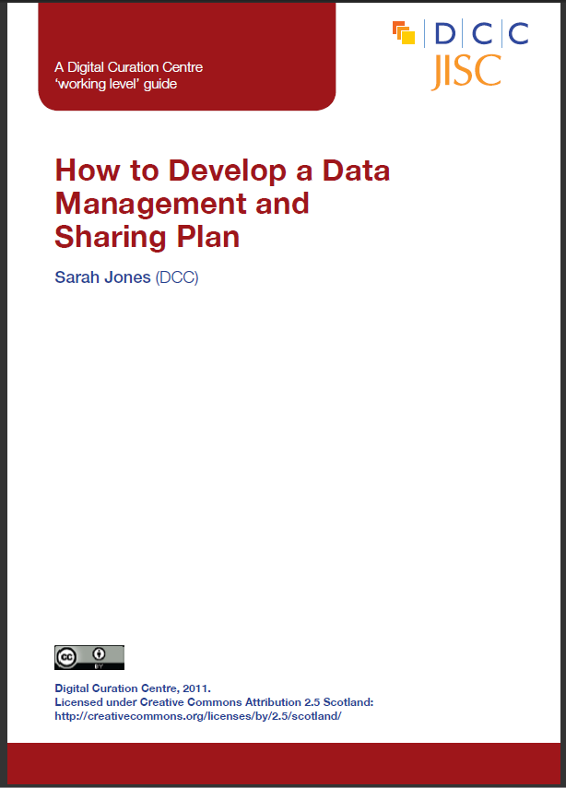

DCC offers DMP guidance and tools
www.dcc.ac.uk/resources/data-management-plans

Slide 37
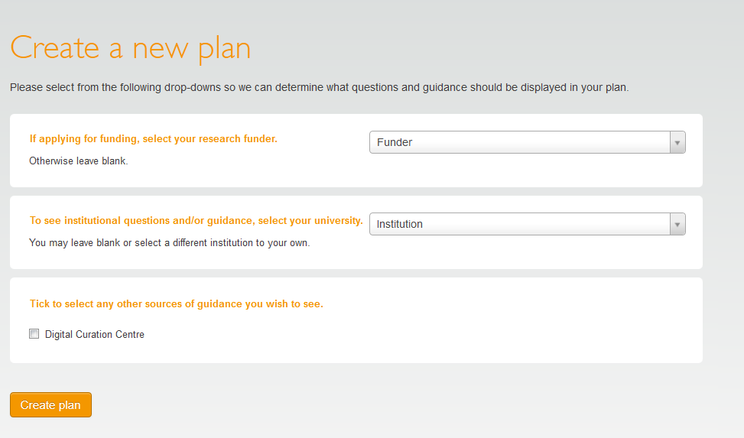
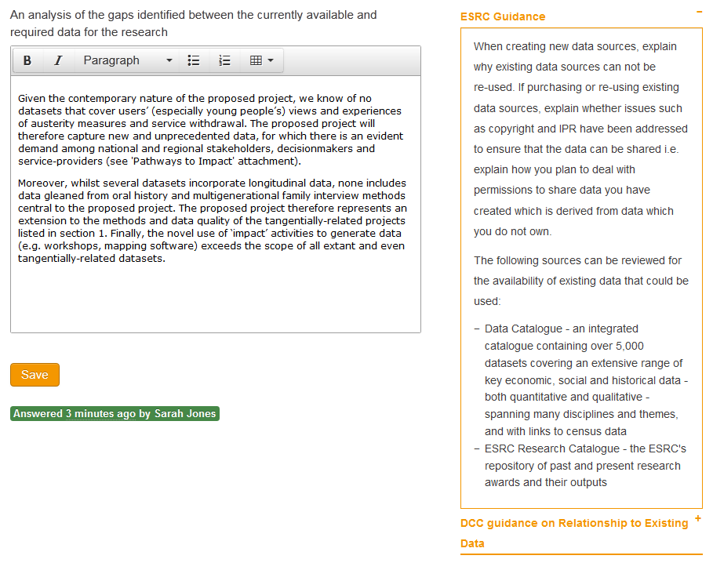
How DMPonline works
Create a plan based on your funder and uni
...and then answer the questions using the tailored guidance provided

Slide 38
Tips for writing DMPs
  Start early - don’t wait until the last minute to plan!
  Seek advice from colleagues, ethics, IT, library, DP/FoI...
  Base plans on available skills & support
  The plan will - and should - change over life of project
  Use plan as a communication tool.

Slide 39
Data management planning exercise
Read through the satirical DMP (5 minutes)
In pairs or small groups, highlight examples of bad practice and suggest alternative methods / approaches (15 minutes)
Feed back (10 minutes)

Slide 40
RDM at Glasgow

